Slide 1

Functions

Slide 2
Recap
Basic Python syntax: print(), input(), int(), while(), for()
If, elif & else
Arrays, with numbers and strings
Build a calculator, Triangular number, build a for with an array

Slide 3
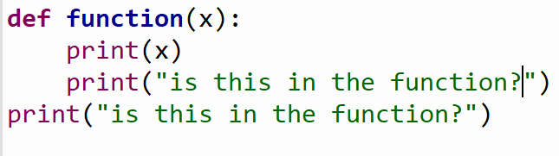
Example
Watch out with the indents!

Slide 4
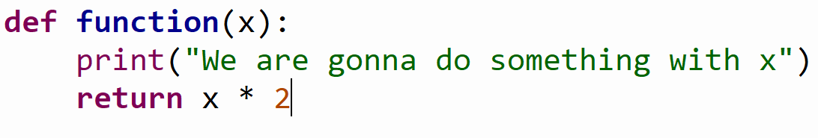
Example
We don’t specify what we return

Slide 5
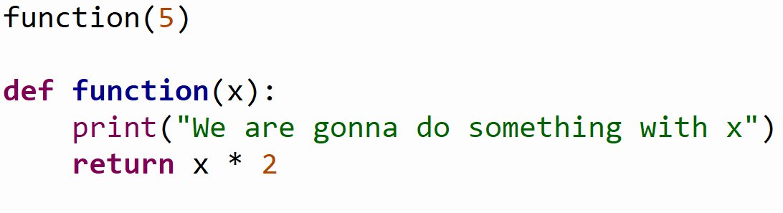
Example
Does this work?

Slide 6
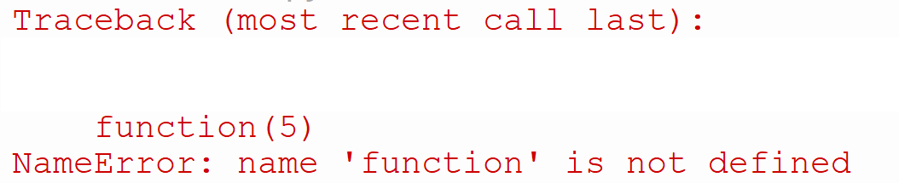
Example

Slide 7
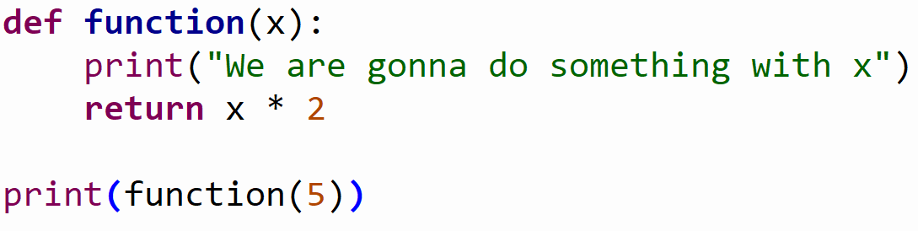
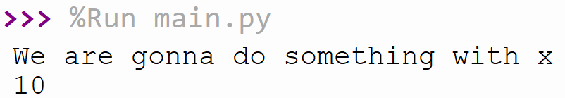
Example

Slide 8
Exercise: Find the word (20 min)
Create a function that takes two parameters, a sentence and a word
Return how many times the word exists in the text

Slide 9
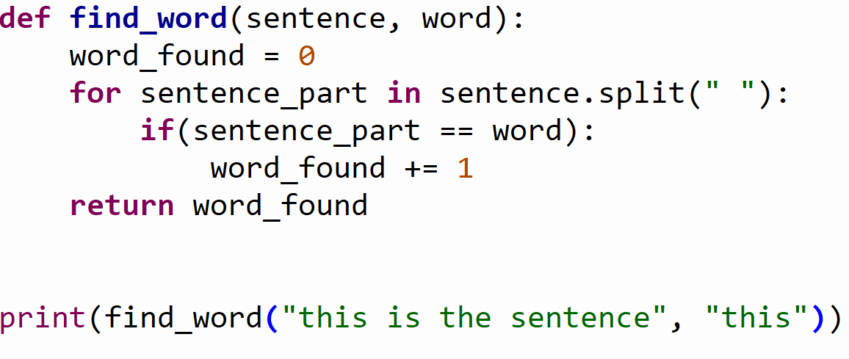
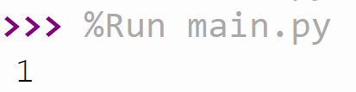
Exercise: Find the word (20 min)

Slide 10

Example
Pandas
TensorFlow
PyTorch
SciPy

Slide 11
Example
math

Slide 12
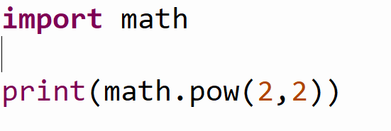
Example

Slide 13
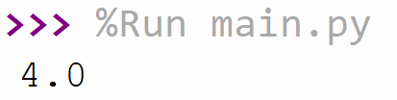
Example

Slide 14
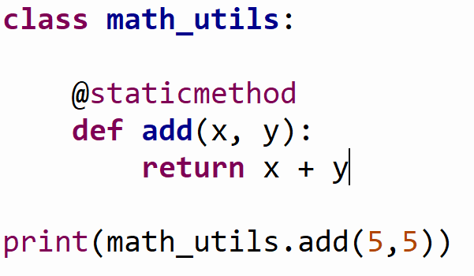
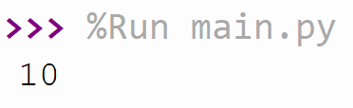
Example

Slide 15
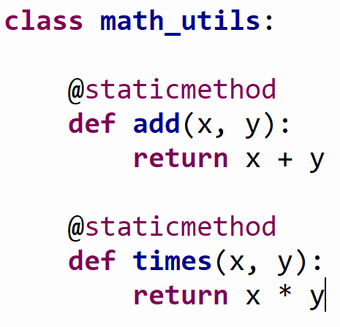
Example

Slide 16
Exercise: Class with static methods (20 min)
Create a class with methods
A method to go from Celsius to Fahrenheit
A method to go from Celsius to Kelvin
A method to go from Fahrenheit to Celsius
A method to go from Fahrenheit to Kelvin
A method to go from Kelvin to Celsius
A method to go from Kelvin to Fahrenheit

Slide 17
KAHOOT!
Notes:
https://create.kahoot.it/details/python-les-2/79f10d12-117f-4a18-b349-d91faebf7d18

Slide 18
Summary
Functions
libraries
Static methods

